Slide 1
Lesson 2 Absolute Value Functions
© Copyright all rights reserved to Homework depot: www.BCMath.ca

Slide 2
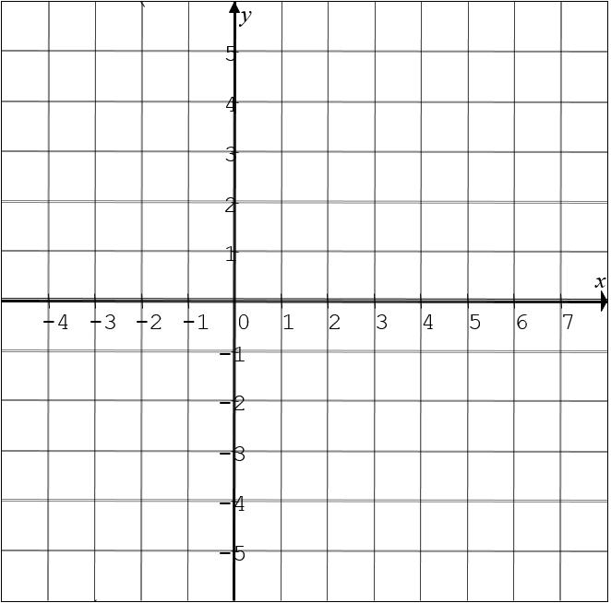
Graphing the ABS Value of a Function
In this chapter we will look at how to graph the absolute value of a function
When graphing the absolute value of a function, any point with a negative y-coordinate will be positive
If the point already had a positive y-coordinate, it will stay positive
ABS of a Linear Function (V shaped Graph)
Linear Function: straight line

Slide 3
Practice: Given the graph of each function, graph the absolute value of it`

Slide 4
Ex: Given the following parabola, graph the Absolute Value of this function:
y
5
Take any part of the graph below
the X-axis and vertically reflect it
x
-5
0
5
Note: Any number outside of the absolute value sign will be performed afterwards
First take the abs of the parabola
First shift the graph 4 units down
-5
Then shift the graph 4 units down
Then take the abs of the parabola
© Copyright All Rights Reserved Homework Depot www.BCMath.ca

Slide 5
II) Piece Wise Function of ABS Value
A piece wise function is a way to expression your equation based on separate domains with your x-intercepts
A negative sign will be placed in front for the part of the graph that was reflected up-side down
y
5
4
The center of the graph is at the x-intercept
3
2
It gets reflected above the x-axis
The x-intercept is used to split the domain into two parts
1
x
-4
-3
-2
-1
0
1
2
3
4
5
6
7
-1
There are two sides: Left & Right
This part of the graph has negative Y-values
-2
-3
Since the right side was reflected place the negative sign to the right piece wise function
-4
-5

Slide 6
How to write the Piece Wise Function:
Steps to find Piece Wise Function for Parabola:
1st Find the X-intercepts of the parabola – Use these x-intercepts to separate the domain as (Left, Middle, Right)
This is the most difficult part, make y=0, and then solve for the “x” value
2nd Write the equation inside the absolute value to the left of each domain, don’t write the absolute value sign!!
3rd Graph the parabola and indicate which parts of the parabola was flipped upside down (left/middle/right)
4th the part that was flipped upside down, place a negative sign in front of the entire equation with brackets around it

Slide 7
Graph the function and:
i) Determine the “x” and “y” intercepts
ii) State the domain and range
iii) State the piece-wise function
y
5
4
X-intercept:
Y-intercept:
3
2
Domain:
Range:
1
x
-4
-3
-2
-1
0
1
2
3
4
5
6
7
-1
-2
-3
-4
-5

Slide 8
Which of the following is the correct piece wise function?

Slide 9
Practice: Graph the following functions and then state the:
i) X and Y intercepts ii) Domain and Range
iii) Piece Wise Function

Slide 10
Graph
Change the equation vertex form so it’s easier to graph
Domain:
Range:
8
y
6
4
2
X: Intercept:
0
x
-4
-2
0
2
4
6
8
10
-2
-4
Y: Intercept:
-6

Slide 11
Graph:
y
5
0
x
-6
-4
-2
0
2
4
6
X: Intercept:
-5
Y: Intercept:
Domain:
Range:

Slide 12
Graph:
y
8
6
4
2
X: Intercept:
0
x
-4
-2
0
2
4
6
8
10
Y: Intercept:
-2
Domain:
Range:
-4
-6

Slide 13
Given the equation:
Which of the following is the correct piece wise function?

